Slide 1
Label Noise in Just-In-Time Software Defect Prediction
Puneet Deshwani
2025MCS013
Under the supervision of Dr. Santosh Singh Rathore
Department of Computer Science and Engineering
Atal Bihari Vajpayee Indian Institute of Information Technology and Management, Gwalior
October 2026

Slide 2
Contents
Overview
Motivation
Related Works
Research Gaps
Objectives and Research Questions
Dataset
Methodology
Results
Conclusion and Future Work
Timeline
References

Slide 3
Overview
Just-in-time software defect prediction (JIT-SDP) predicts, at commit time, whether a code change is likely to introduce a defect, so that review and testing effort can be directed to risky changes [6].
The models are trained on past commits. Each commit is described by change metrics and is labelled as clean or defect-introducing.
These labels are not recorded in the repository. They are inferred by the SZZ algorithm, which traces the lines changed in a bug-fixing commit back to the commits that last modified them [11].
Bug-fixing commits often contain unrelated changes (tangled commits), so SZZ produces wrong labels. Only 17% to 32% of the changed lines in bug-fixing commits contribute to the fix [5].

Slide 4
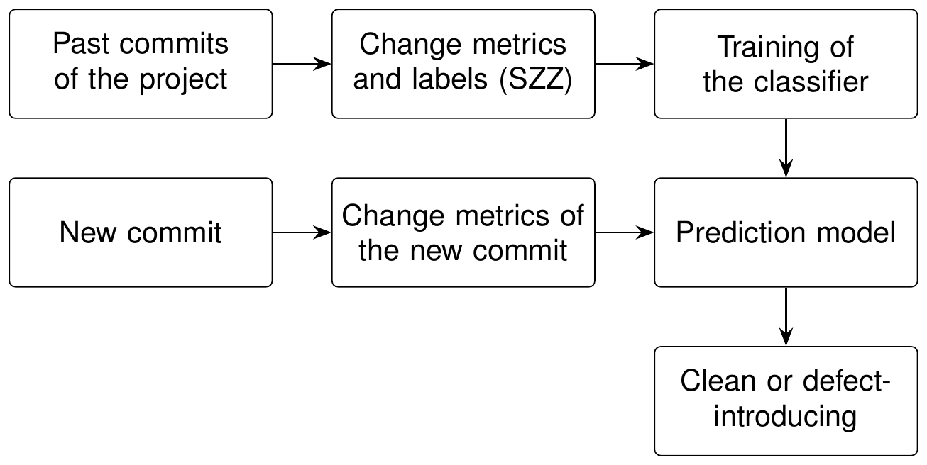
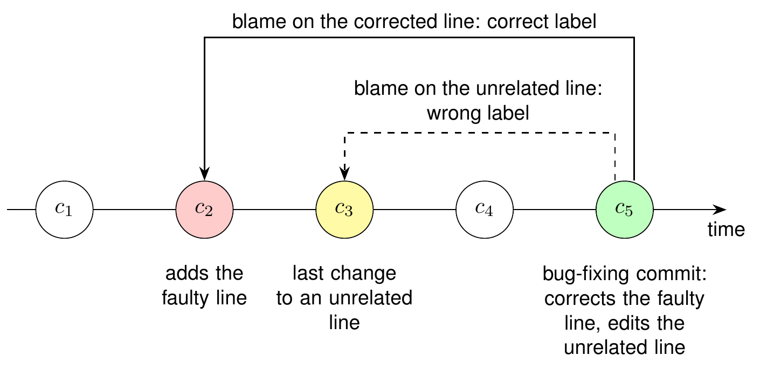
Overview
Figure 1: Workflow of JIT-SDP
Figure 2: Labelling with SZZ and a wrong label caused by an unrelated change

Slide 5
Motivation
JIT-SDP models are trained and tested on the same SZZ labels. A model is then rewarded for reproducing the errors of SZZ, and the effect of label noise on the reported performance is not visible.
Random k-fold cross-validation is still widely used, although it trains the model on commits that are newer than the test commits [3].
In practice the label of a commit arrives late (verification latency). In our data the median delay is 113 days, and 53% of the defect labels arrive after 90 days [1].
It is therefore not known how much SZZ label noise costs a model that is evaluated in a realistic setting.

Slide 6
Related Works - 1
Title | Author | Dataset | Key Takeaways
When Do Changes Induce Fixes? (2005) [11] | Jacek Śliwerski | Mozilla and Eclipse | Proposes the SZZ algorithm: lines changed by a bug fix are traced back with annotate (blame) to find the bug-introducing changes
A Framework for Evaluating the Results of the SZZ Approach for Identifying Bug-Introducing Changes (2017) [2] | Daniel A. da Costa | Ten open-source projects | Criteria for evaluating SZZ implementations; proposes MA-SZZ, which ignores meta-changes
Evaluating SZZ Implementations Through a Developer-Informed Oracle (2021) [10] | Giovanni Rosa | 1,930 bug-fixing commits in which the developer names the introducing commit | Compares SZZ variants against the oracle; R-SZZ performs best (precision about 66%); releases PySZZ
A Fine-grained Data Set and Analysis of Tangling in Bug Fixing Commits (2022) [5] | Steffen Herbold | LLTC4J: manually labelled bug-fixing commits of Apache Java projects | Only 17% to 32% of the changed lines contribute to the bug fix; tangling adds noise to defect data
The Impact of Changes Mislabeled by SZZ on Just-in-Time Defect Prediction (2021) [4] | Yuanrui Fan | 126,526 changes from ten Apache projects | Compares four SZZ variants with RA-SZZ as the reference; labels of AG-SZZ reduce performance significantly

Slide 7
Related Works - 2
Title | Author | Dataset | Key Takeaways
A Large-Scale Empirical Study of Just-in-Time Quality Assurance (2013) [6] | Yasutaka Kamei | Six open-source and five commercial projects | 14 change metrics in five groups; 68% accuracy and 64% recall with logistic regression
Are Fix-Inducing Changes a Moving Target? (2018) [7] | Shane McIntosh | Qt and OpenStack (37,524 changes) | Properties of fix-inducing changes change over time; models lose predictive power as they age
Class Imbalance Evolution and Verification Latency in Just-in-Time Software Defect Prediction (2019) [1] | George G. Cabral | Ten GitHub projects | Online JIT-SDP with delayed labels (90-day waiting period); proposes ORB for evolving class imbalance
Deep Just-in-Time Defect Prediction: How Far Are We? (2021) [12] | Zhengran Zeng | Open-source projects with over 310,000 changes | Deep models do not consistently beat simple ones; LApredict (logistic regression on added lines) is best in most cases
The Best of Both Worlds: Integrating Semantic Features with Expert Features for Defect Prediction and Localization (2022) [8] | Chao Ni | JIT-Defects4J: 21 Java projects, 27,319 commits | Dataset built from manually validated bug-fixing lines; proposes JIT-Fine

Slide 8
Research Gaps
Noise of SZZ labels not measured over complete project histories
Models tested against the same labels on which they are trained
Effect of label noise not separated from the effect of the evaluation procedure
Label noise not studied under verification latency
Effect of SZZ noise on online learners not understood, and no remedy for this setting

Slide 9
Objectives
Objective 1: To quantify the label noise introduced by SZZ and its variants, by comparing their labels with independent reference labels over complete project histories.
Objective 2: To measure the effect of this noise on JIT-SDP models under a realistic evaluation that respects the order of the commits and the delay of the labels, and to separate it from the effect of the evaluation procedure.
Objective 3: To identify how the noise affects an online learner, and to develop a noise-aware online learning approach that reduces its effect. (planned for MTP III and MTP IV)

Slide 10
Research Questions
RQ1: How much do the labels of SZZ variants disagree with one another and with independent reference labels, and what type of error does each variant make?
RQ2: How does the choice of the label source affect the measured performance of JIT-SDP models under different evaluation settings?
RQ3: Through which mechanism does label noise reduce the performance of an online learner, and which type of error is responsible? (planned for MTP III)
RQ4: Can an online learner be made less sensitive to SZZ label noise without access to clean labels? (planned for MTP IV)

Slide 11
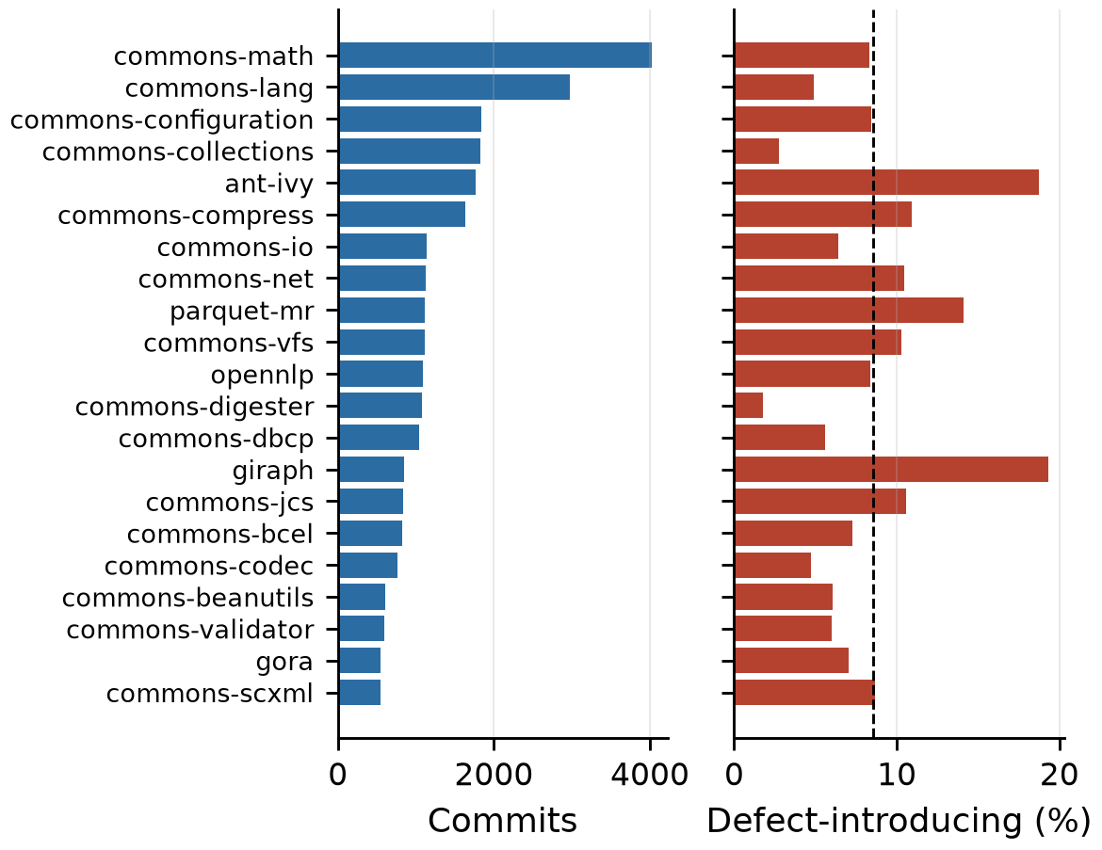
Dataset
JIT-Defects4J [8]: 27,319 commits from 21 Apache Java projects (2001 to 2019)
2,332 commits (8.54%) are defect-introducing; 5,453 commits are bug-fixing
Reference labels: bug-fixing lines validated by at least three of four annotators, then traced back with git blame
Features: the 14 change metrics of Kamei et al. [6]
Seven labels per commit: reference label and six SZZ variants
Label arrival times taken from the dates of the bug-fixing commits (median delay 113 days)
Figure 3: Commits and defect rate of each project

Slide 12
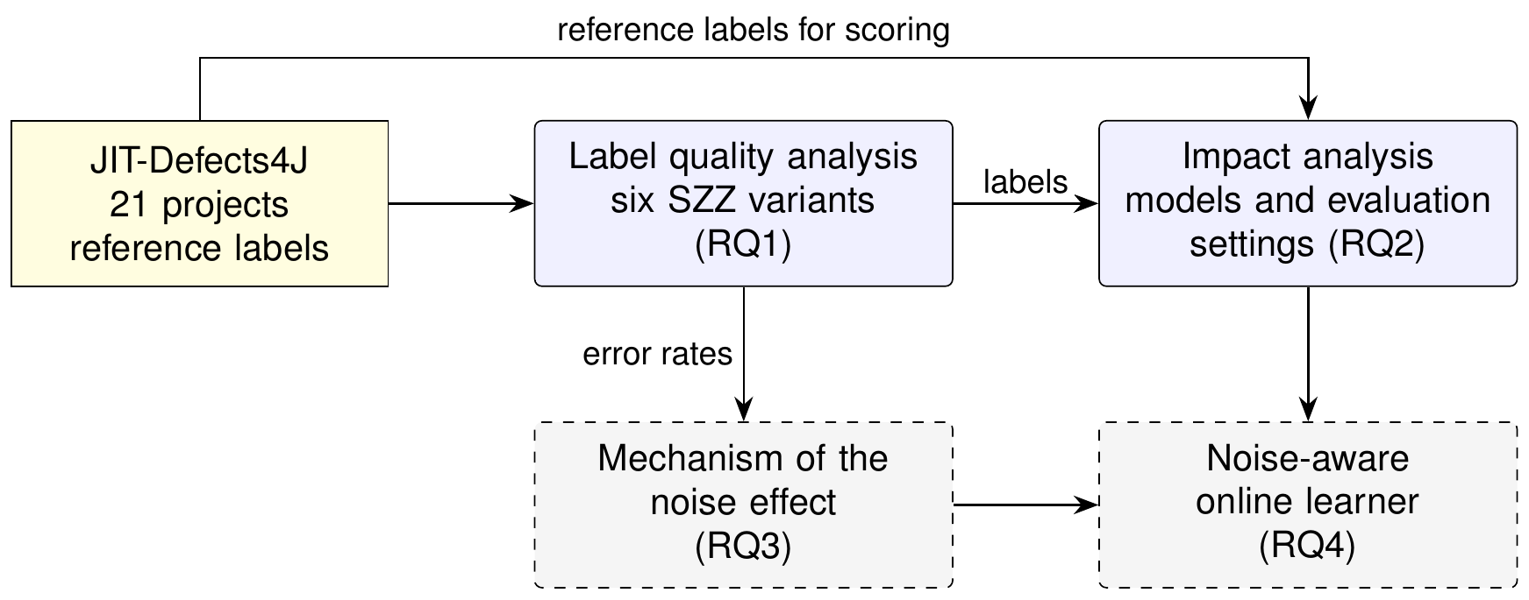
Methodology
Figure 4: Overview of the work. Solid boxes: MTP II (completed). Dashed boxes: MTP III and MTP IV (planned)

Slide 13
Methodology
SZZ labels: six variants (B-, AG-, MA-, L-, R- and RA-SZZ) run with PySZZ on the same 5,453 bug-fixing commits
Label quality: precision, recall, false-alarm rate ρ₀, miss rate ρ₁ and Cohen's κ against the reference labels
Models: LApredict (logistic regression on lines added) [12], a JITLine-based random forest with SMOTE [9], and ORB (online ensemble) [1]
Scoring: against the held-out reference labels, and against the training labels (self-scoring) for comparison
Statistics: paired by project (n = 21), Wilcoxon signed-rank test, Hodges-Lehmann estimate with bootstrap confidence interval, Holm correction over all 74 tests
Scale: 3 models, 7 label sources, 4 evaluation settings, 10 seeds, 16,380 runs

Slide 14
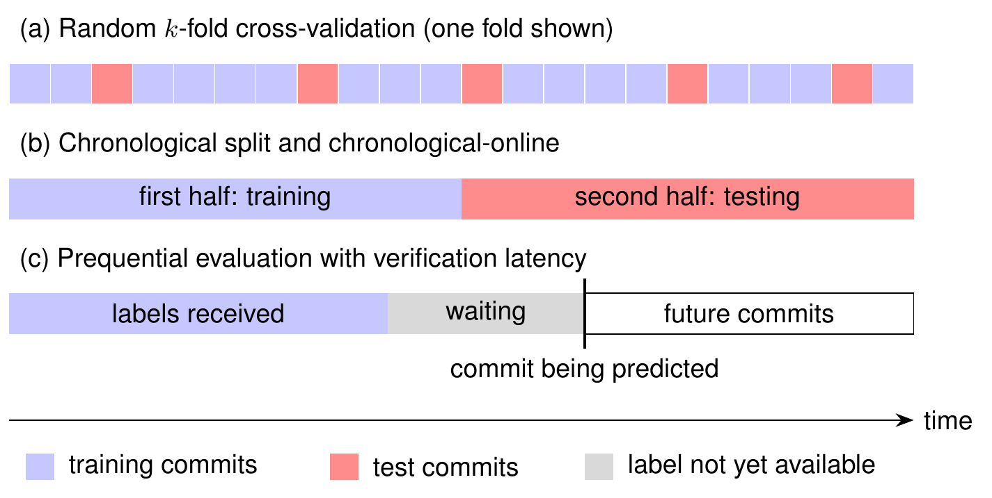
Methodology: Evaluation Settings
Figure 5: Evaluation settings. Commits of a project are ordered by time from left to right

Slide 15
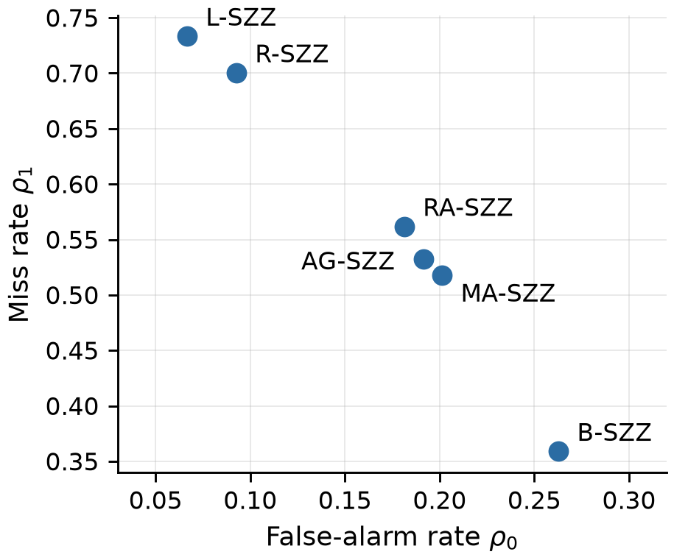
Results: Quality of SZZ Labels (RQ1)
Variant | Flagged | Precision | Recall | ρ₀ | ρ₁ | κ
B-SZZ | 8,060 | 0.186 | 0.641 | 0.263 | 0.359 | 0.179
AG-SZZ | 5,876 | 0.186 | 0.467 | 0.192 | 0.533 | 0.163
MA-SZZ | 6,154 | 0.183 | 0.482 | 0.201 | 0.518 | 0.161
L-SZZ | 2,287 | 0.272 | 0.267 | 0.067 | 0.733 | 0.202
R-SZZ | 3,015 | 0.232 | 0.300 | 0.093 | 0.700 | 0.183
RA-SZZ | 5,553 | 0.184 | 0.438 | 0.181 | 0.562 | 0.158
Precision is at most 0.272: more than 72% of the flagged commits are clean according to the reference
The noise is class-conditional: B-SZZ mainly gives false positives, L-SZZ and R-SZZ mainly miss defects
Figure 6: False-alarm rate and miss rate

Slide 16
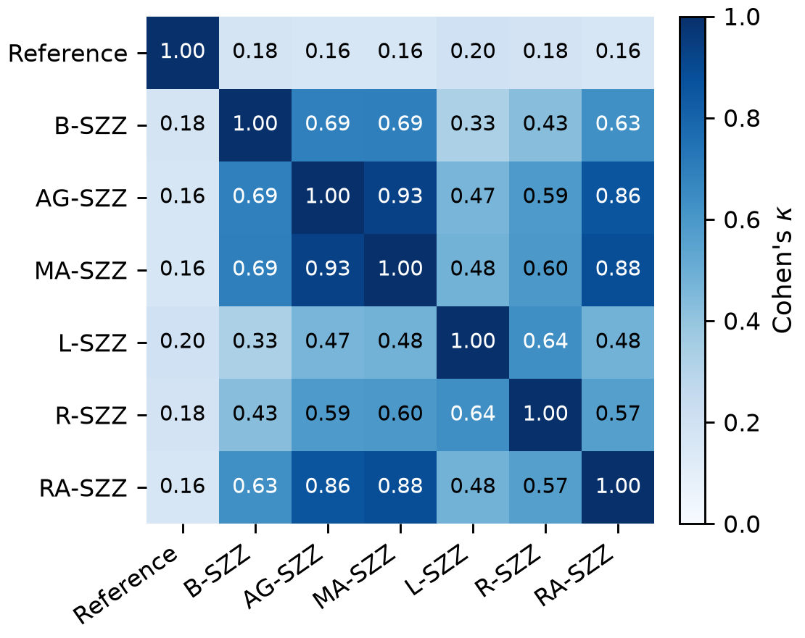
Results: Agreement between Variants (RQ1)
Agreement with the reference labels: κ = 0.16 to 0.20
Agreement among the variants: κ = 0.33 to 0.93
Agreement between SZZ variants is therefore not evidence of correct labels
Filtering also removes correct labels: 30% to 60% of the true positives of B-SZZ are lost in the refined variants
Figure 7: Cohen's κ between the label sets

Slide 17
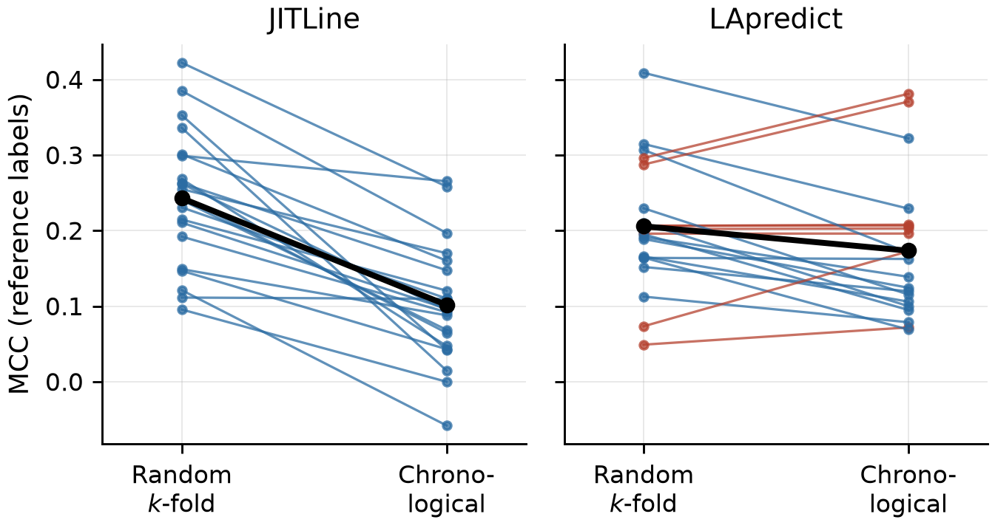
Results: Effect of the Evaluation Setting (RQ2)
Random k-fold gives a higher MCC than the chronological split in all 14 comparisons
JITLine: 0.243 against 0.102 (+0.137), in 21 of 21 projects
LApredict: +0.034, not significant
With the chronological split the simpler model is better (0.173 against 0.102)
Figure 8: MCC of each project (models trained on reference labels)

Slide 18
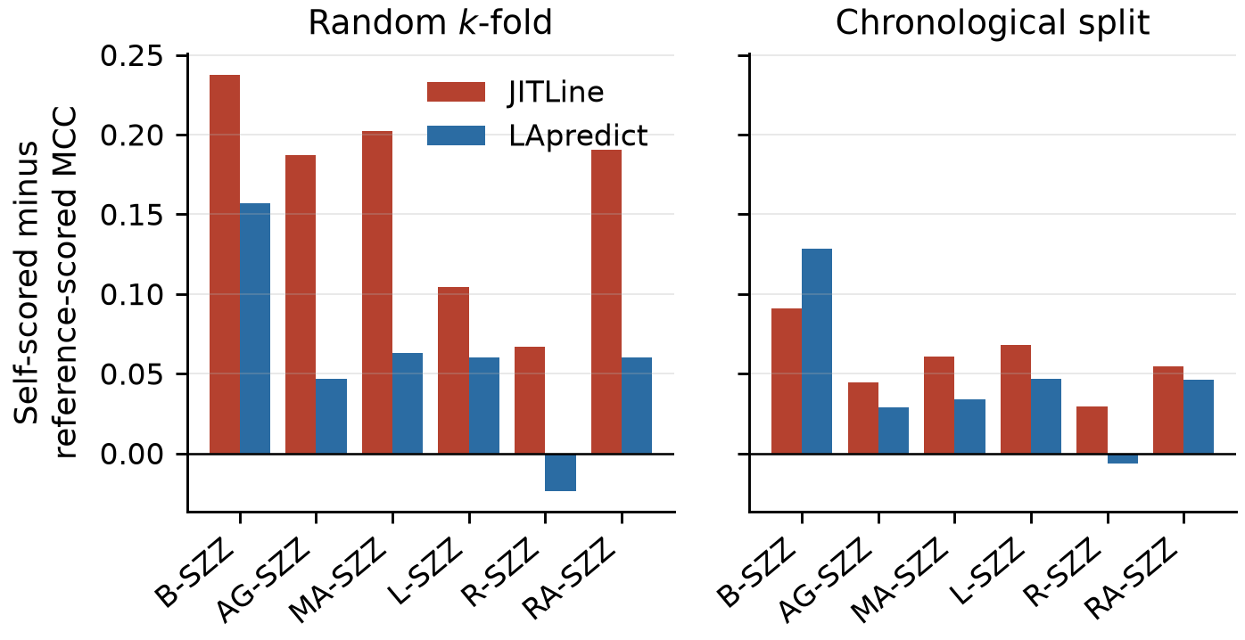
Results: Effect of Scoring against Training Labels (RQ2)
Scoring a model against its own SZZ labels gives a higher MCC than scoring against the reference
JITLine with B-SZZ (k-fold): 0.413 against 0.175 (+0.230)
Significant for five of six variants with JITLine, only for B-SZZ with LApredict
The errors of B-SZZ are learnable: AUC 0.60 against 0.51 with permuted labels
Figure 9: Self-scored minus reference-scored MCC

Slide 19
Results: Effect of the Label Source, Online Setting (RQ2)
ORB evaluated on the commit stream with verification latency, scored against the reference labels
The model trained on reference labels is better than all six SZZ-trained models
Loss of 0.034 to 0.064 MCC, significant for five of six variants after correction over all tests
Training labels | MCC | Loss | 95% CI | Projects | p (corrected)
Reference | 0.097 | - | - | - | -
B-SZZ | 0.058 | 0.041 | [0.022, 0.052] | 18/21 | 0.006
AG-SZZ | 0.036 | 0.060 | [0.029, 0.085] | 17/21 | 0.024
MA-SZZ | 0.035 | 0.064 | [0.039, 0.085] | 18/21 | 0.004
L-SZZ | 0.058 | 0.034 | [0.014, 0.055] | 16/21 | 0.124
R-SZZ | 0.032 | 0.060 | [0.042, 0.082] | 19/21 | < 0.001
RA-SZZ | 0.039 | 0.058 | [0.036, 0.081] | 18/21 | 0.006

Slide 20
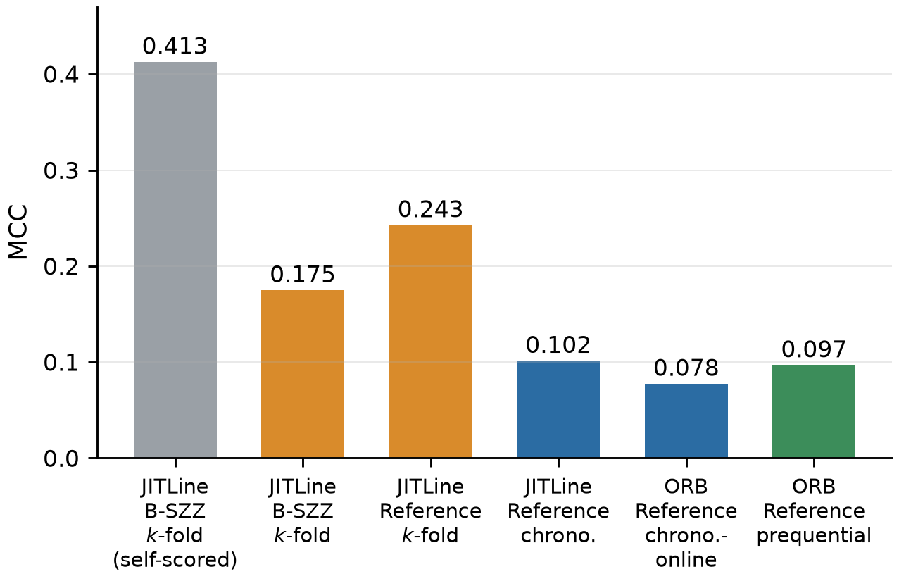
Results: Combined View
Common practice (JITLine, B-SZZ labels, k-fold, self-scored): 0.413
Same predictions scored against reference labels: 0.175
Reference labels with chronological split: 0.102
Online learner with verification latency: 0.097
The evaluation procedure accounts for more of the difference than the label noise
Figure 10: MCC under increasingly realistic conditions

Slide 21
Conclusion
The labels of all six SZZ variants differ strongly from the reference labels (precision 0.18 to 0.27). The noise is class-conditional and depends on the variant.
SZZ variants agree with each other much more than with the reference, so their agreement does not indicate correct labels.
Random k-fold cross-validation and scoring against the training labels overestimate the performance (+0.137 and up to +0.230 MCC), more so for the complex model.
In the online setting with verification latency, training on SZZ labels loses 0.034 to 0.064 MCC compared with the reference labels (0.097).
RQ1 and RQ2 are answered in MTP II. The cause of the loss and a remedy are the subject of MTP III and MTP IV.

Slide 22
Future Work
MTP III: identify the cause of the loss (RQ3) by injecting noise into the reference labels at the measured rates, and by repairing the B-SZZ labels one error type at a time
Controls in MTP III: equal number of corrected labels of each type, immediate delivery of repaired labels, and a condition without label delay; the resampling rate of ORB will be recorded
MTP IV: design a noise-aware online learner (RQ4) that improves the performance on SZZ labels without reducing it on clean labels, with the evaluation plan fixed before the experiments
Further evaluation: effort-aware measures and other online learners, if time permits

Slide 23
Timeline
MTP I
Literature Survey,
Dataset and
Methodology
MTP III
Mechanism of the
Noise Effect
(RQ3)
MTP II
Label Quality and
Impact Analysis
(RQ1, RQ2)
MTP IV
Noise-Aware
Online Learner
(RQ4)
Figure 11: Timeline

Slide 24
References I
[1] | George G. Cabral et al. “Class Imbalance Evolution and Verification Latency in Just-in-Time Software Defect Prediction”. In: Proceedings of the 41st International Conference on Software Engineering (ICSE). 2019, pp. 666-676.
[2] | Daniel Alencar da Costa et al. “A Framework for Evaluating the Results of the SZZ Approach for Identifying Bug-Introducing Changes”. In: IEEE Transactions on Software Engineering 43.7 (2017), pp. 641-657.
[3] | Davide Falessi et al. “On the Need of Preserving Order of Data When Validating Within-Project Defect Classifiers”. In: Empirical Software Engineering 25 (2020), pp. 4805-4830.
[4] | Yuanrui Fan et al. “The Impact of Changes Mislabeled by SZZ on Just-in-Time Defect Prediction”. In: IEEE Transactions on Software Engineering 47.8 (2021), pp. 1559-1586.
[5] | Steffen Herbold et al. “A Fine-grained Data Set and Analysis of Tangling in Bug Fixing Commits”. In: Empirical Software Engineering 27.6 (2022), p. 125.
[6] | Yasutaka Kamei et al. “A Large-Scale Empirical Study of Just-in-Time Quality Assurance”. In: IEEE Transactions on Software Engineering 39.6 (2013), pp. 757-773.
[7] | Shane McIntosh and Yasutaka Kamei. “Are Fix-Inducing Changes a Moving Target? A Longitudinal Case Study of Just-in-Time Defect Prediction”. In: IEEE Transactions on Software Engineering 44.5 (2018), pp. 412-428.
[8] | Chao Ni et al. “The Best of Both Worlds: Integrating Semantic Features with Expert Features for Defect Prediction and Localization”. In: Proceedings of the 30th ACM Joint European Software Engineering Conference and Symposium on the Foundations of Software Engineering (ESEC/FSE). 2022, pp. 672-683.

Slide 25
References II
[9] | Chanathip Pornprasit and Chakkrit Tantithamthavorn. “JITLine: A Simpler, Better, Faster, Finer-grained Just-In-Time Defect Prediction”. In: Proceedings of the 18th International Conference on Mining Software Repositories (MSR). 2021, pp. 369-379.
[10] | Giovanni Rosa et al. “Evaluating SZZ Implementations Through a Developer-Informed Oracle”. In: Proceedings of the 43rd International Conference on Software Engineering (ICSE). 2021.
[11] | Jacek Śliwerski, Thomas Zimmermann, and Andreas Zeller. “When Do Changes Induce Fixes?”. In: Proceedings of the International Workshop on Mining Software Repositories (MSR). 2005, pp. 1-5.
[12] | Zhengran Zeng et al. “Deep Just-in-Time Defect Prediction: How Far Are We?”. In: Proceedings of the 30th ACM SIGSOFT International Symposium on Software Testing and Analysis (ISSTA). 2021.

